Slide 1
PLANT
WATERING SYSTEM
Presented By Nayan DaY & Sajia Akter
reallygreatsite.com

Slide 2
Introduction
Conventional Watering Method use a lot of water and needless to say,a lot of it is wasted on a daily basis.
With the help of a smart watering system, plants get just the right amount of water they need.
Using Arduino, it is possible to water plants automatically..
02

Slide 3
Equipments We Used
Arduino Uno
Water Pump
5v Relay Module
Jumper Wires
Soil Moisture Sensor
Plastic Tube
01

Slide 4
Block Diagram of the Project
Sensor
Arduino
Relay
Water pump
03

Slide 5
Working
Soil moisture sensor always monitor the moisture in the soil and sends information to the Arduino.
Arduino signals the to motor ON/OFF.
04

Slide 6
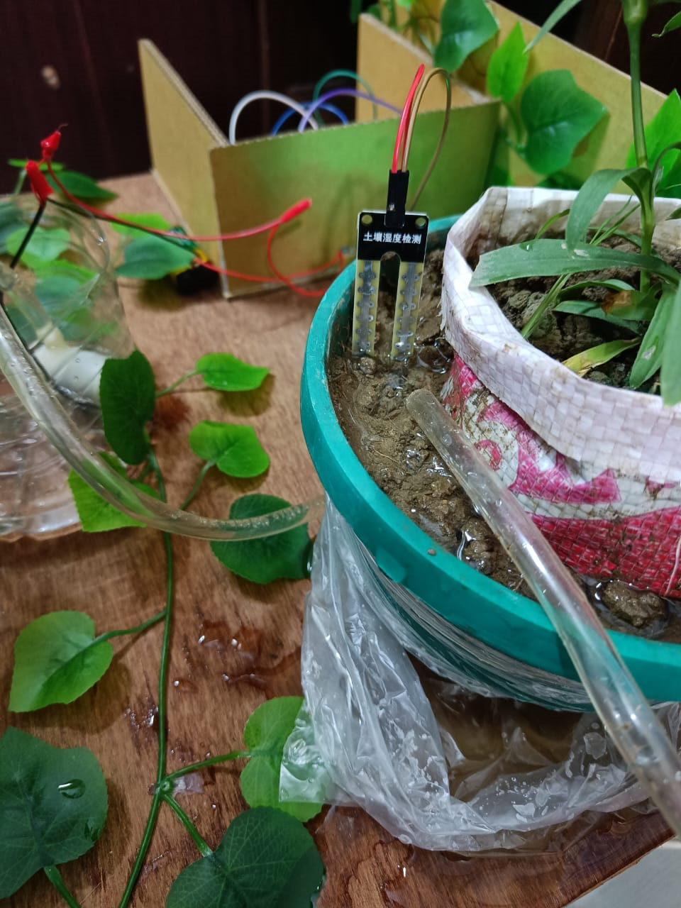
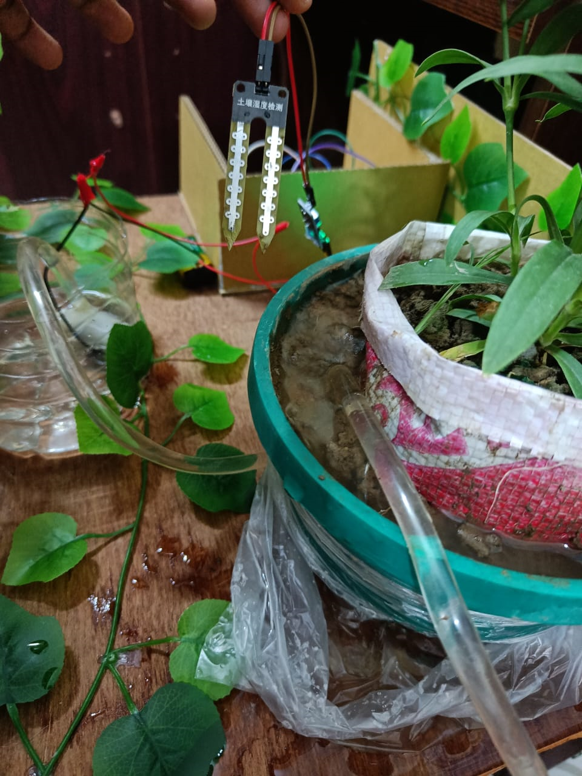
The Final Project Output
Moisture sensor detect soil moisture
Water Flow after removing sensor
reallygreatsite.com

Slide 7

ADVANTAGE of THE SYSTEM
Water Conservation
Increases Productivity
This system is completely automated and there is no need for any human intervention.
Saves Time
05

Slide 8
Conclusion
Adding an automated plant watering system to the garden or agricultural field will help all farmer's plants reach their fullest potential as well as conserve water.
08

Slide 9
Thank You
Lend a hand to save trees
reallygreatsite.com

